Slide 1
Advanced Spreadsheets
CMPS1024
Inaldi Gomez

Slide 2
Objective
Excel Review
Name Range
Linking Sheets
Using Excel to Manage List
Charts
Vlookup
Lesson Practice

Slide 3
Review
Cell
Sheets
Name Box
Formula Bar
Ribbon
Options – Backstage view

Slide 4
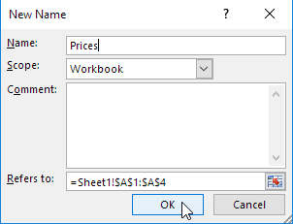
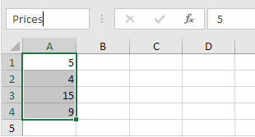

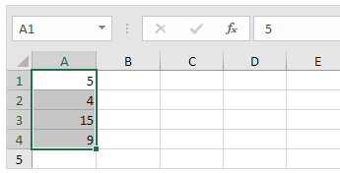
Name Range
Create Name Range to use in Formulas
This makes formulas easier to understand
Select the range
Formula Bar >Define Name
Enter a name > OK
Shot-cut to above
How to use Name Range?

Slide 5
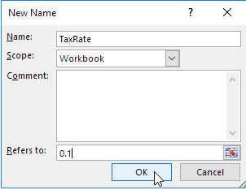

Named Constant
Formula Tab> Define Name
Enter a Name, type a value and Click OK
You can now use the Named Constant in your formula

Slide 6
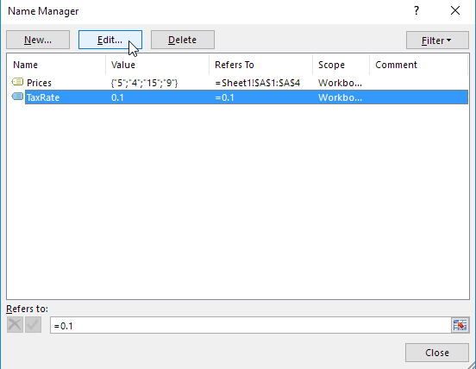

Name Manager
To Edit and Delete Name Range or Named Constant
From formula tab, in the Defined Names group, click on Name Manager

Slide 7
Link Excel Spreadsheet
A formula that pulls in data from a cell into another worksheet in a dynamic manner
When values in the Source worksheet changes then
the Destination worksheet will actively update itself,
this is what makes excel a powerful software
Cells in one worksheet linked to cells in one or more other worksheets.
What is a link in Excel?

Slide 8
Why use Linked Spreadsheet
Pros of Linked Spreadsheet
Less work- no need to replicate data and formulas in multiple sheets
Saves time
Reduce errors
Improves data integrity

Slide 9
Creating a Worksheet Link Method 1
TIP: Ensure the cell in both Source Sheet and Destination Sheet have equal format
From the source worksheet proceed to select the cell you want to link to and copy (Ctrl +C)
Go to the destination worksheet and select the cell where you will enter the link and past the link (Ctrl +V)
Reopen the Source worksheet and type the ESC button to remove the animated border on the cell
Creating a Worksheet Link Method 2
Go to the destination worksheet cell and type in the = (equal sign)
In the source worksheet, select the cell that contains the data and press the enter key.
Do the same for a range of cells

Slide 10
Manually Entering Links
Once linking cells in worksheet come from the same workbook, follow the following format:
=SheetName!CellReference eg. =sheet1!B2
If the worksheet appear in different workbooks but are in the same folder (directory) follow this format:
=[filename.xlsx]sheetname!CellReference
If the workbooks are in different folders, you wold have to indicate the complete file path.

Slide 11
TIPS on Links
Location:
prior to creating links consider where you store your files. Note that if your worksheets are all in one workbook, moving the workbook to another folder is not a problem.
Protected:
Protecting worksheet to lock the cells
Notate Link:
To keep track of what cells contain links,
format cells containing links with a fill colour.
Automatic Calculation:
Excel Options>Formulas>Calculation Options>Automatically
No Circular Links:
Worksheet A reference Worksheet B, Worksheet B reverences Worksheet A

Slide 12
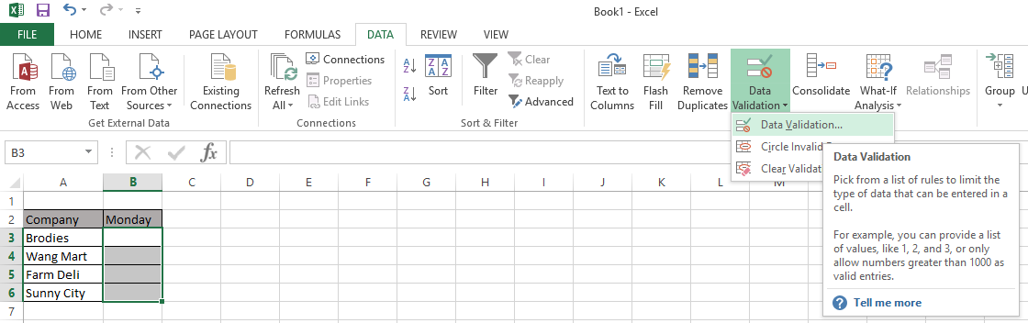
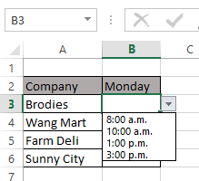
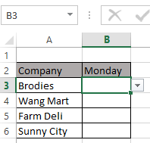
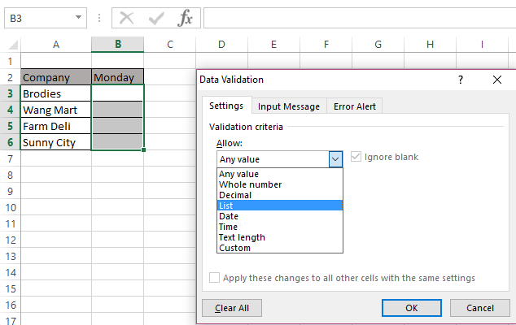
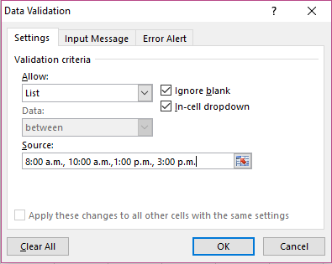
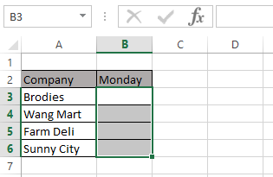
Manage List
Drop Down List limits the entries used in a cell.
Select the Cells that will use the list
3) In the Data Validation Dialog Box select List
4) Use a coma Delimited source data
2) Select Data> Data Validation

Slide 13
Types of Chart
VLOOKUP
LESSON

